Slide 1
Summer training project
Tours and travels
By
Varunpreet kaur
Jashanpreet kaur
Incharge: Er. Gurleen kaur
hod: prof.(dr.) minakshi sharma

Slide 2
agenda
INTRODUCTION
DATA FLOW DIAGRAM
PROJECT SCREENSHOTS
FUTURE GOAL
SUMMARY

Slide 3
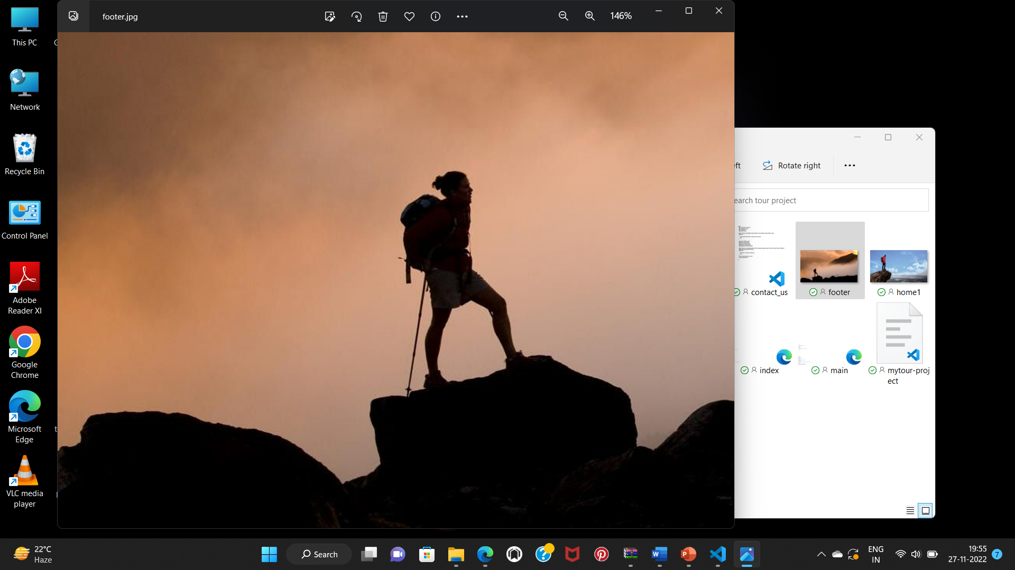
INTRODUCTION
TOURS AND TRAVEL: This is an online project designed using
HTML and JAVA SCRIPT. The purpose of this project is to provide information the about tour packages available in INDIA.
There are different types of customers who have their own taste for choosing destinations . Furthermore dwellers prefer to have a package tour so they don’t need to bother about the searching for places to travel at the moment .
In addition to this masses also look for the best deals and packages which are being provided to them.
Tours and travel provide the best travel packages and various exiting trips!
It aims to maximize travel policy compliance all areas including best fares , allowances and approval.

Slide 4
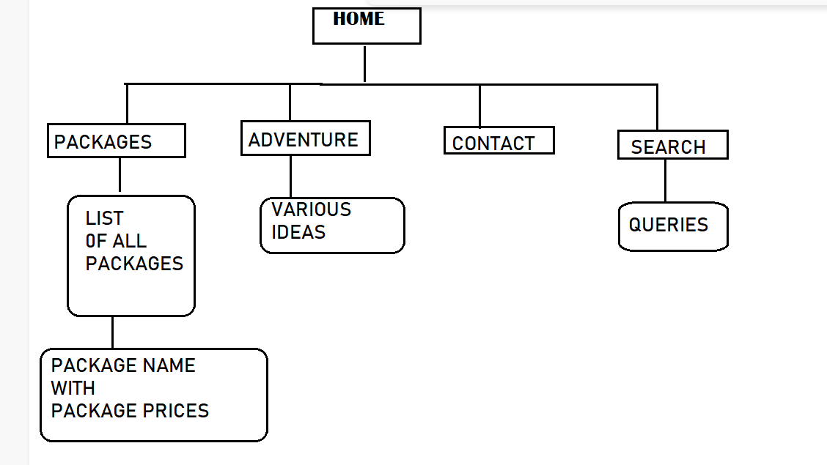
DATA FLOW DIAGRAM

Slide 5
PROJECT SCREENSHOTS

Slide 6
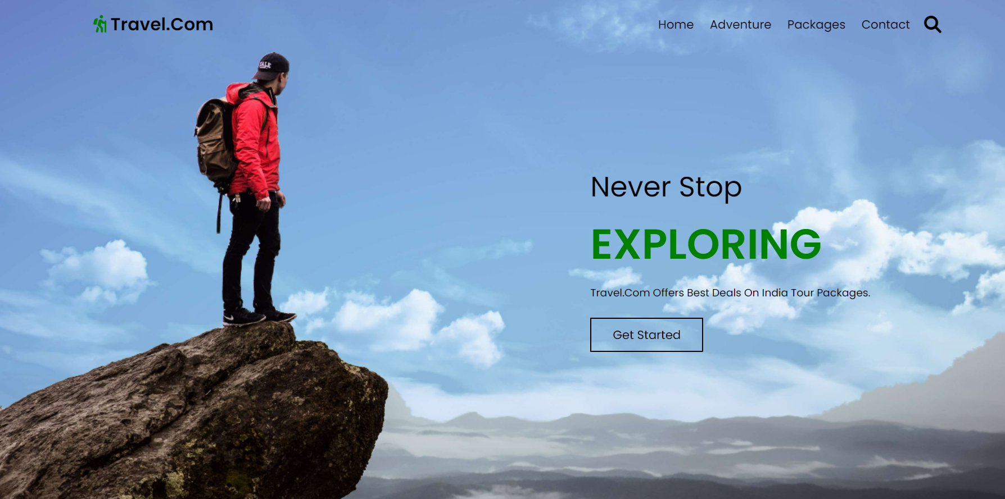
HOME PAGE

Slide 7
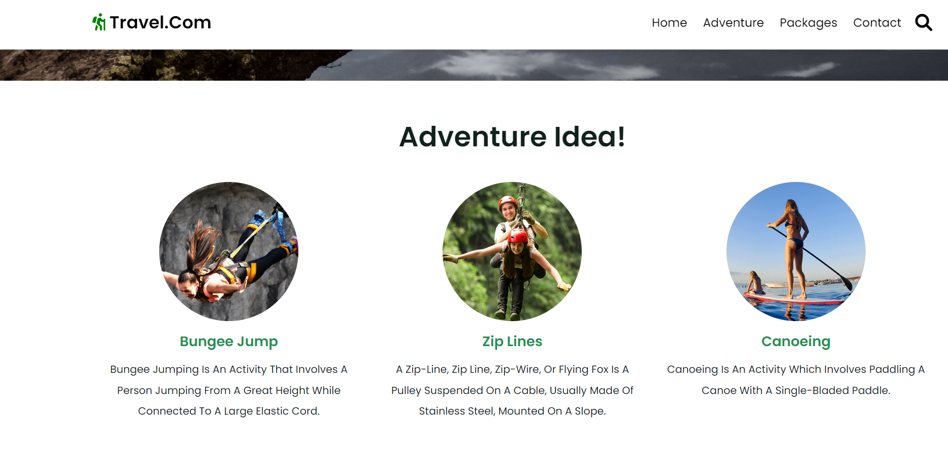
ADVENTURE IDEAS!
It provides the information about exciting
adventurous
activities to be
carried out

Slide 8
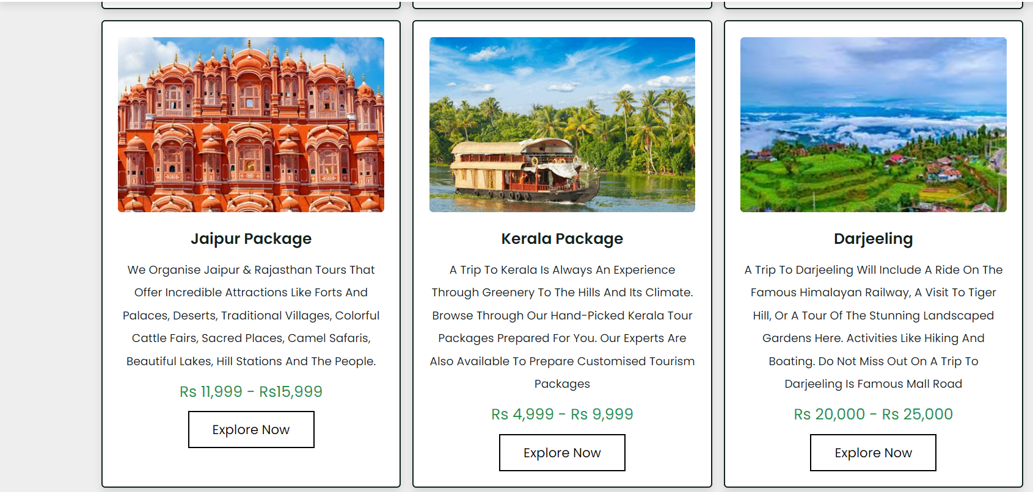
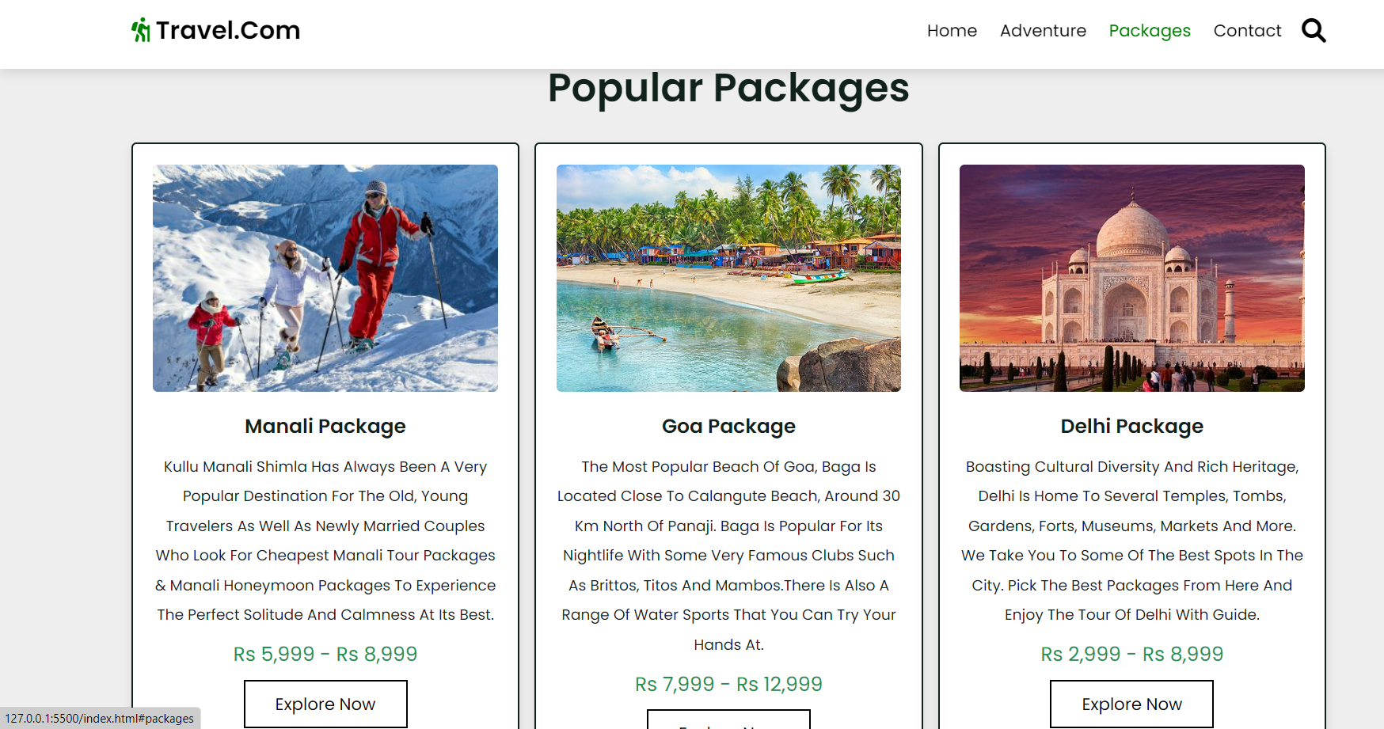
PACKAGES

Slide 9
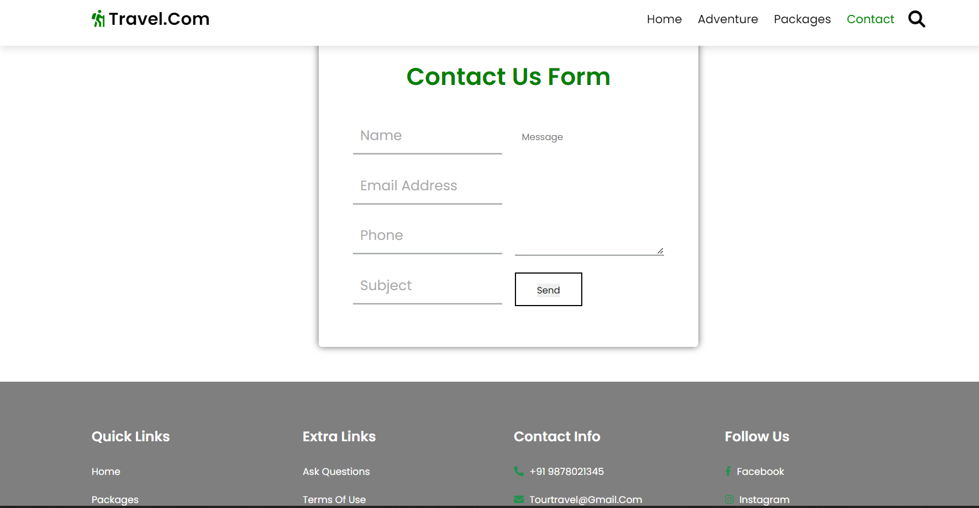
CONTACT

Slide 10
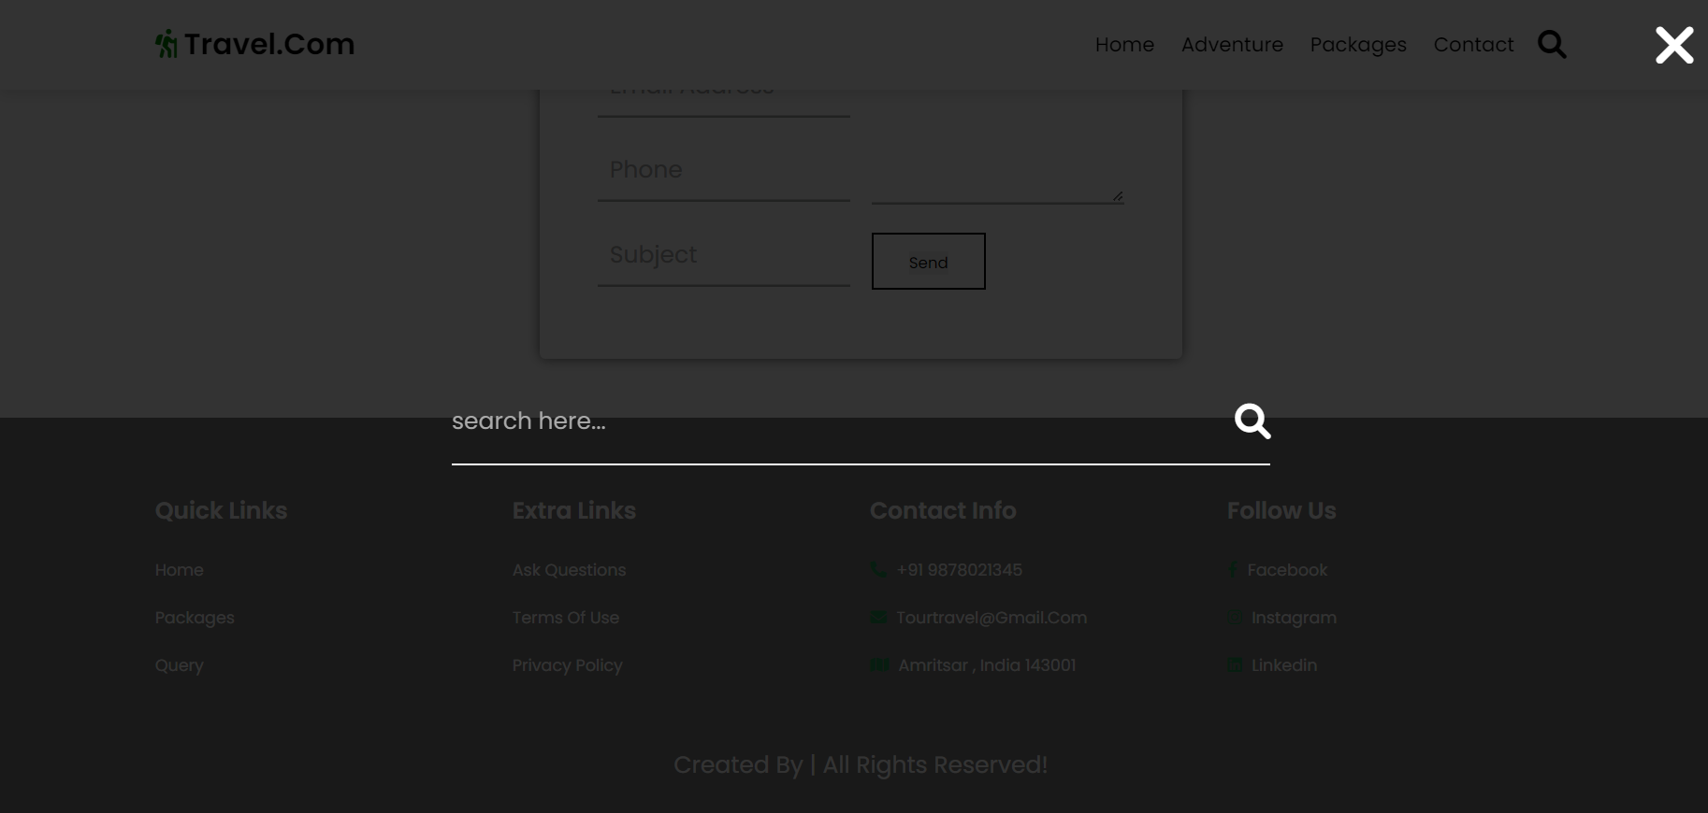
SEARCH
Searching for any query

Slide 11
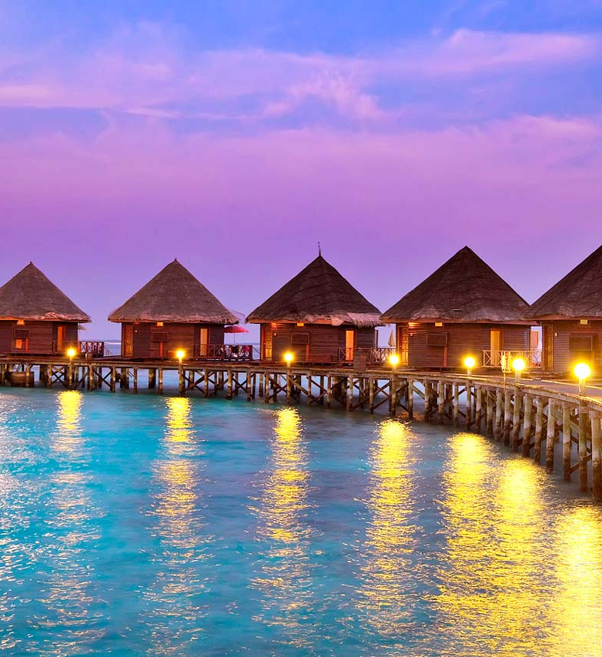
FUTURE GOAL
WE WILL INCLUDE MORE FUNCTIONALITY
AS PER REQUIRED BY THE USER.
WE WISH TO IMPROVE OUR HOME PAGE AS IT IS THE MAIN THING THAT ATTRACTS THE USER.
NOT A SINGLE WEBSITE IS EVER COMPLETED FOREVER FIRSTLY BECAUSE THERE IS ALWAYS SOMETHING NEW REQUIREMENT GROWING DAY BY DAY.

Slide 12
THANK YOU

